Slide 1


Dataset Augmentation Approaches for Recommender Systems
Michal Krzysztof Polak Szarkowicz
118304271

Slide 2

What are Recommender Systems?
An RS is simply a program that provides a user with items they might like and allow for exploring novel items
We come in contact with recommender systems (RS) daily thought services like Netflix, Spotify and soon, your next meal at McDonald’s will be personalised by an AI
RS help users to navigate the sea of endless content by serving content they’ll like, as well as discovering novel items

Slide 3
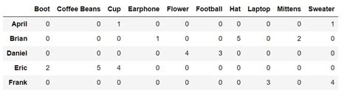
Sparsity and cold-starts
However, an important issue persists; sparsity. In practice, commercial datasets (such as Netflix’s or Amazon’s) have thousands of users and items, and millions of ratings. It is not uncommon to see datasets that are 95% empty
Cold starts occur when instances have little or no interaction with the dataset
We propose three data augmentation methods that help to solve the issue of sparsity and cold-starts: boostrapping data, recursive imputation and co-training

Slide 4
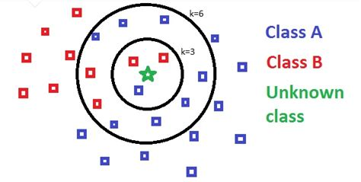
K Nearest Neighbours
KNN is the simplest RS. It calculates recommendations based on instances closest to a user or item. The closer two instances are the more similar they are assumed to be
Quick, effective and well studied
A majority vote of the K most similar neighbours decides on the class
Give recommendations based on similar user or similar items

Slide 5
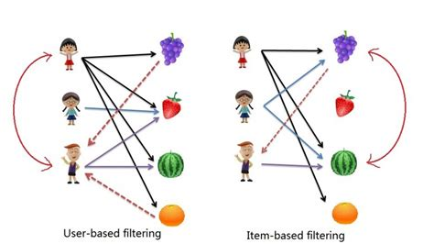
User and Item Collaborative filtering
When getting nearest neighbours, KNN get either look at users or items
When using user based KNN, it finds the users most similar to the candidate user and gives suggestings based on that nearest neighbour
When using item based KNN, it finds the item most similar to the candidate item and gives suggestings based on that nearest neighbour

Slide 6
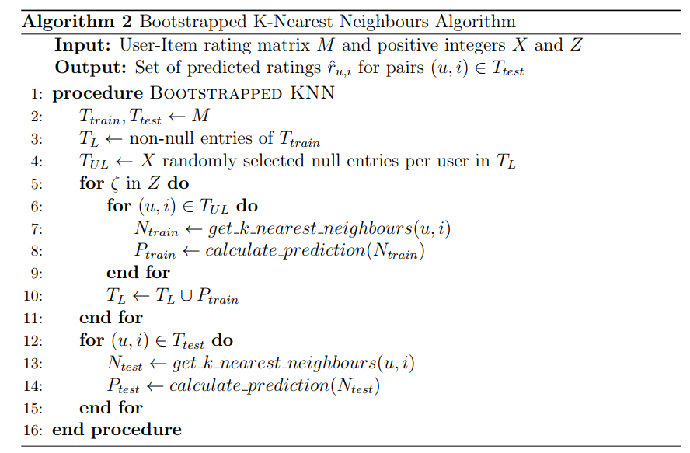
Bootstrapped KNN
Bootstrapping is commonly used in statistics when analysing samples without having to examine the entire population
Consists of a training and prediction phase. Training phase is where new predictions are added to the trainset
Reduces sparsity quickly and without using any extra external data

Slide 7
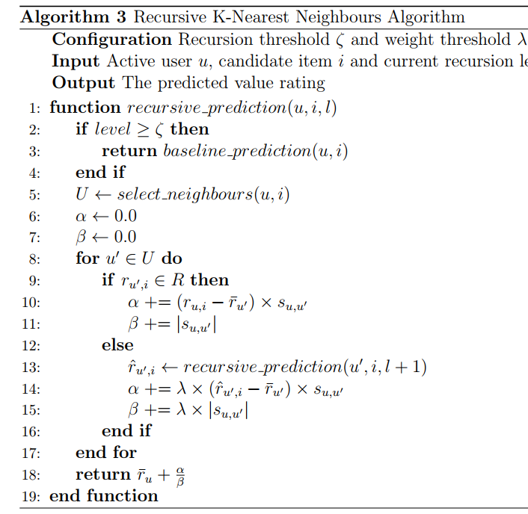
Recursive KNN
Proposed by Zhang and Pu [2007]
Doesn’t augment the dataset, rather imputes missing ratings
Lets highly correlated (similar) users play a role in the calculation by recursively looking at the user’s neighbours (and possibly their neighbours)

Slide 8
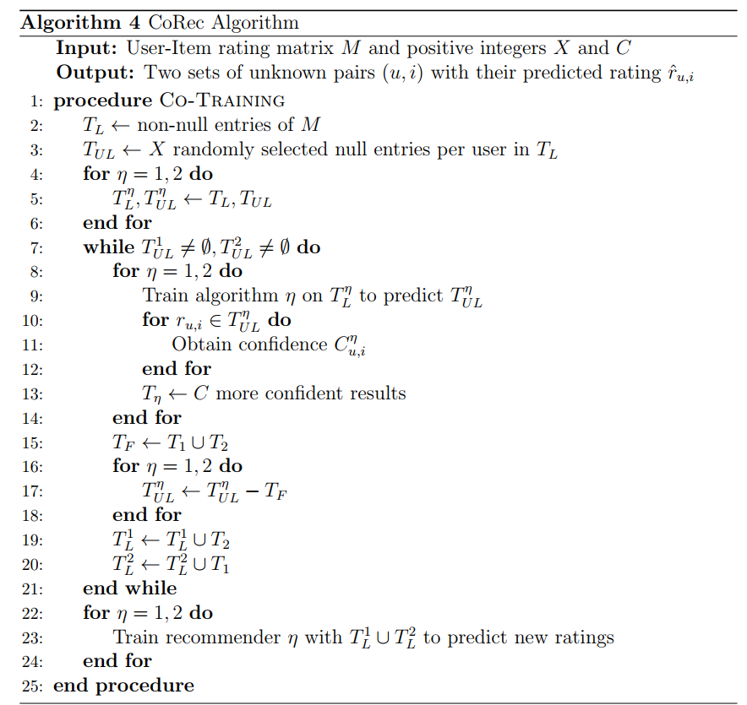
CoREC: A co-training approach
As the name suggests, it co-trains two KNNs that iteratively feed each other with the other’s recommendation. This increases the number of ratings in the dataset and thus decreases sparsity and cold-starts
As opposed to bootstrapped KNN, it only uses confident prediction to co-train the next model, meaning it’s not as naive as the bootstrapping approach

Slide 9
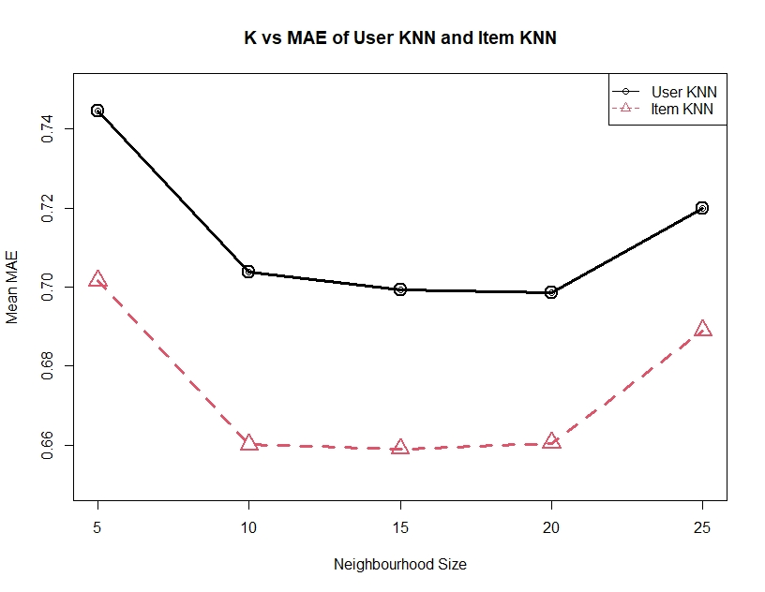
User VS Item KNN
As we can see, both user and item KNN perform best with neighbourhood size around 10-20
Item based KNN outperforms User based by 5.9%
Suggests similities between items give more insight than users

Slide 10
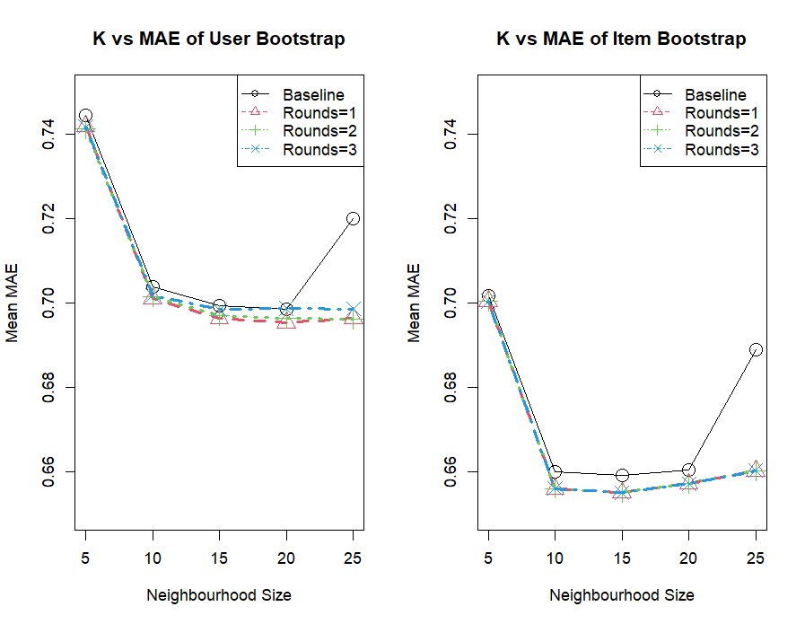
Bootstrapped KNN
Both User and Item Bootstrap offer slight improvement, 0.47% and 0.62% respectively when enriching the dataset at least once. Enriching it more doesn’t seem to make a difference
User and Item Bootstrap work best when K = 20 and K = 15 respectively
Again the Item-based CF approach beats the User-based CF approach by 5.80%

Slide 11
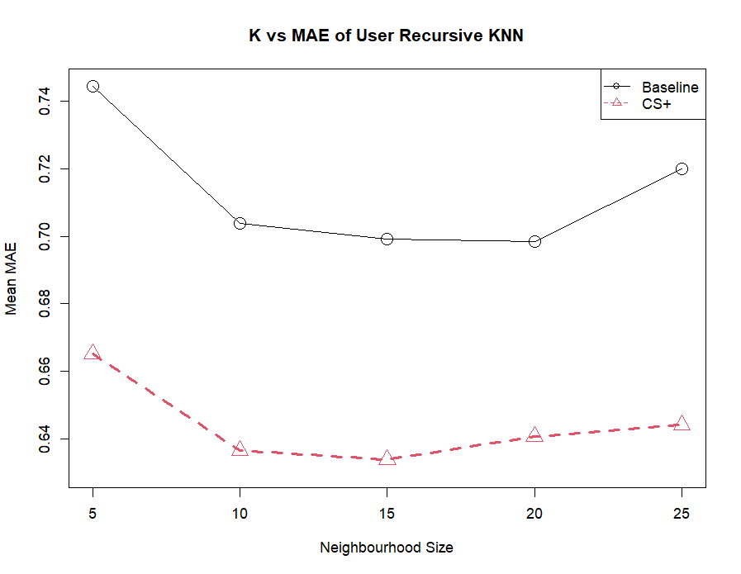
Recursive KNN Results
Recursive User KNN offers the best results by far, reducing error by a record 9.23%
We use the optimal neighbour selection startegy suggested by Zhang and Pu, combination strategy with overlap

Slide 12

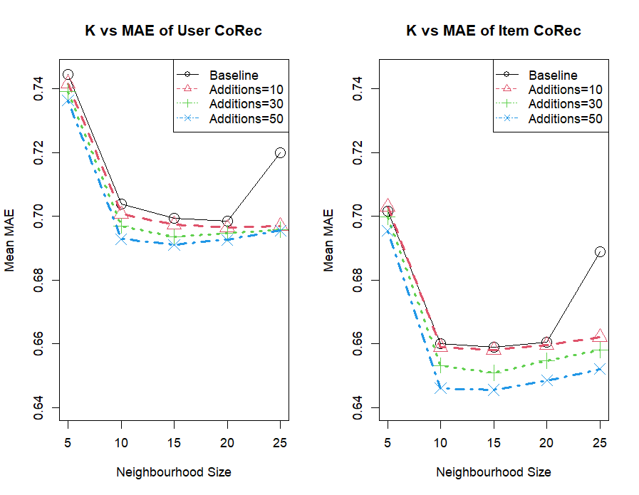
Corec results
Both the User and Item CoRec approach offer significant improvements over their baseline counterparts, by 1.08% and 2.04% respectively
The more additions the better the accuracy is
User and Item CoReC work best when K = 15 and additions = 50
Once again, the Item CF approach outperforms the User CF approach, this time by 6.59%

Slide 13
Conclusions
Recursive User KNN offered the best improvement of 9.25% from the baseline
The approach that offered the best results in the Item-CF approach was CoRec by 2.0%
All improvements in accuracy are statistically significant for p < 0.01
In conclusion, dataset augmentation techniques offer promising results for reducing sparsity and cold-starts without having to use external data
In future work, we’d like to test and compare the algorithms using more modern metrics that measure novelty, diversity and serendipity of recommendations

